Slide 1

Healthcare Analytics for Doctor Visits
- OMKAR VINOD GAIKWAD

Slide 2

PROBLEM STATEMENT
“To analyze healthcare data and identify the factors that influence the frequency of doctor visits among individuals.”

Slide 3
Project Description
This project focuses on analyzing healthcare data to understand the factors that may influence the number of times a person visits a doctor. The dataset contains information about gender, age, income, illnesses, health condition, reduced activity, chronic conditions, and healthcare support. By analyzing these factors, the project aims to identify patterns and relationships associated with doctor visits. The analysis can help students understand how personal, financial, health-related, and healthcare-support factors are connected to healthcare utilization.

Slide 4

WHO ARE THE END USERS?
Healthcare Professionals – To understand patient health patterns and doctor visit frequency.
Hospitals and Clinics – To analyze healthcare utilization and plan services.
Healthcare Administrators – To support healthcare resource and service planning.
Researchers and Data Analysts – To study factors associated with healthcare usage.
Government and Health Organizations – To support healthcare planning and policy decisions.
Students and Educators – To learn and demonstrate healthcare data analytics.

Slide 5

Technology Used
Programming Language: Python
Data Analysis: Pandas, NumPy
Data Visualization: Matplotlib, Seaborn
Machine Learning: Scikit-learn
Development Environment: Jupyter Notebook / Google Colab
Dataset Format: CSV
Data Storage: CSV Dataset
Output: Graphs, charts, statistical analysis, and insights

Slide 6
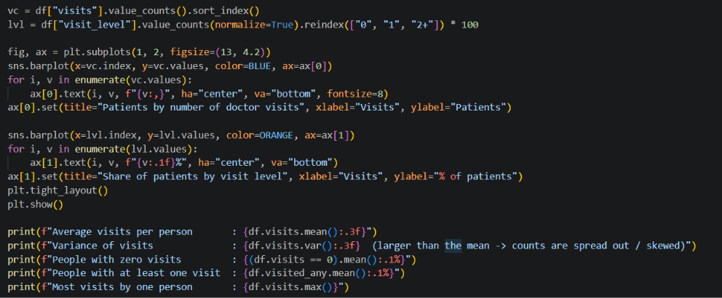
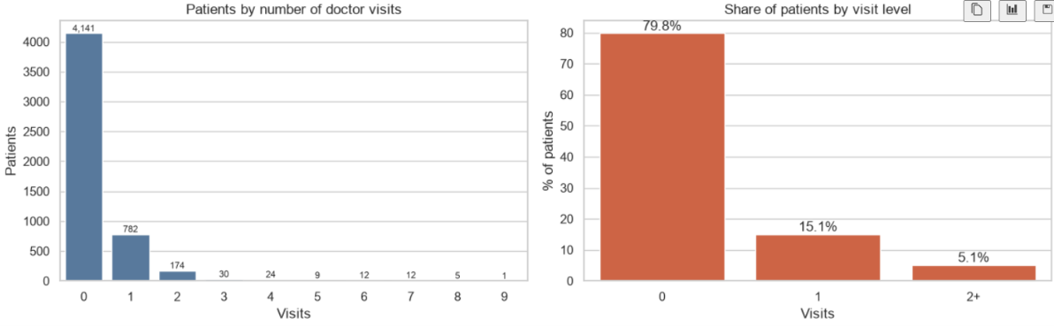
RESULTS
GIT HUB LINK :
https://github.com/omkarg984/DIY-Healthcare-Project

Slide 7
THANK YOU
.
.

